Slide 1
Energy Efficiency

Slide 2
An isolated system is a system which no energy or matter can enter or leave. The universe is the only true isolated system, but calorimeters are very close approximations of isolated systems. This is because calorimeters are highly insulated since they are used to measure heat in chemical reactions.
A closed system is a system where energy can enter or leave but matter remains in the system. Water and coolant in car engines is an example of a closed system.
An open system is a system which energy and matter can enter or leave. An example of an open system is the ocean.

Slide 3
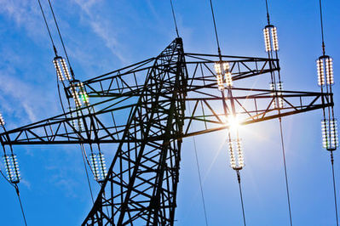
We classify energy as being either high grade or low grade.
High grade energy resources transform energy efficiently. Some examples are electrical energy, solar energy, and chemical energy.
Low grade energy resources transform energy inefficiently. The main low grade energy resource is heat.
Open systems always transform high grade energy resources into low grade energy resources.

Slide 4

Energy efficiency (η) shows how much input energy produces useful output energy.
E_{in}​ represents energy input, total energy used, or total work input.
E_{out}​ represents energy output, useful energy transferred, or useful work output.
This may seem confusing, but it is essentially useful energy or work you get out of the system divided by the total energy or work you put into the system.

Slide 5

Energy efficiency can never be greater than 100%. This is because the conservation of energy means that we can't get more energy out of a system than we put in.
Most systems are a lot less efficient than we might expect. For example, cars have an efficiency of η≈30%. Only around 30% of the chemical energy produced from fuel combustion is used to power the car. This might seem very low, and this is because cars produce a lot of heat and energy which makes them less efficient.

